Slide 1
Walmart Superstore Sales Analysis

Slide 2
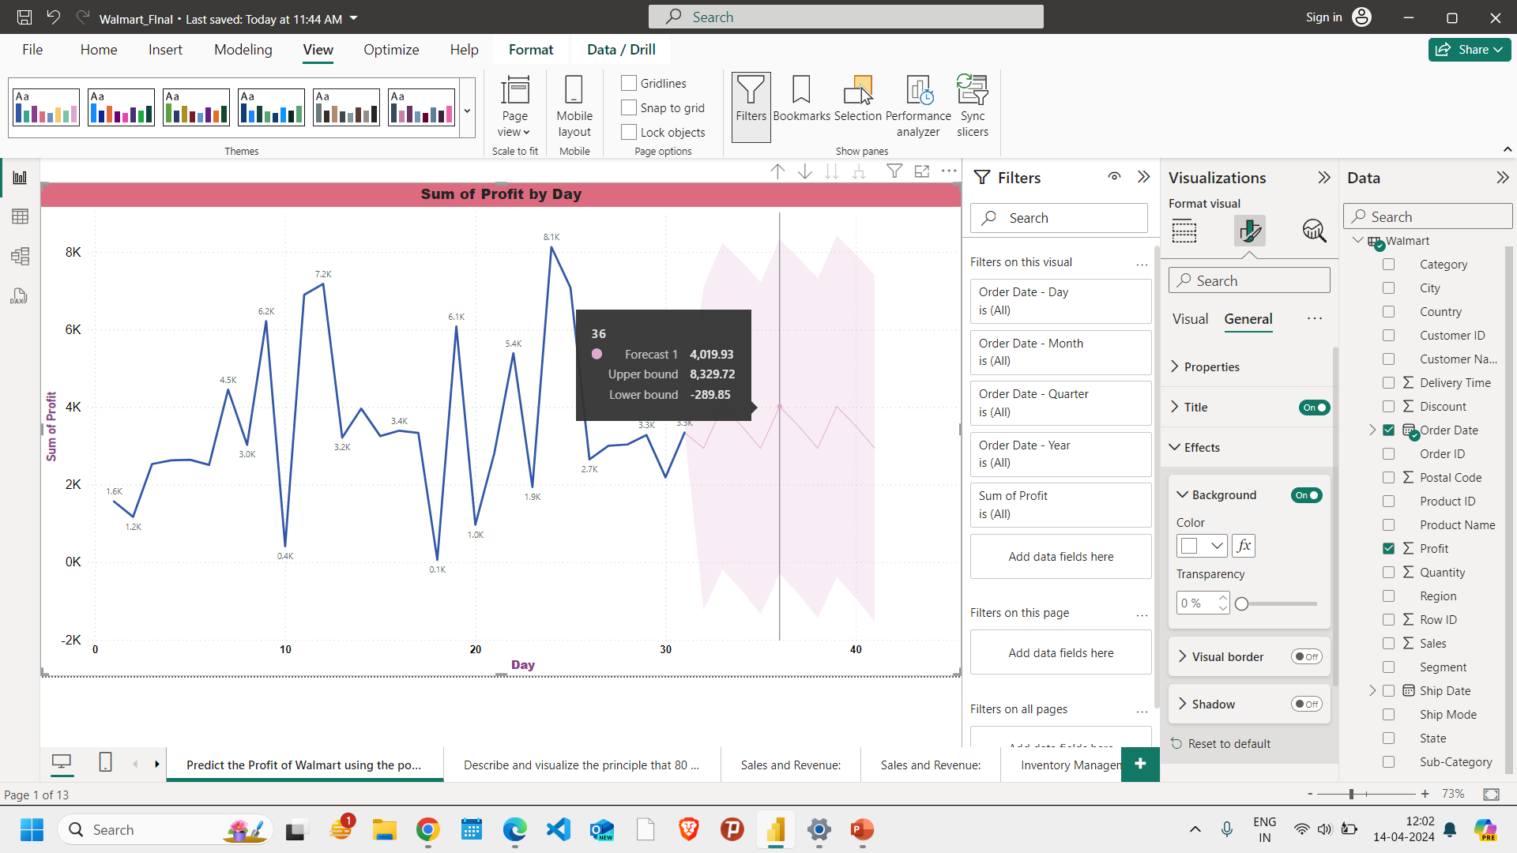
Predict the Profit of Walmart using the power analysis and also represent the data in hierarchial as well as the area in series of data points.

Slide 3
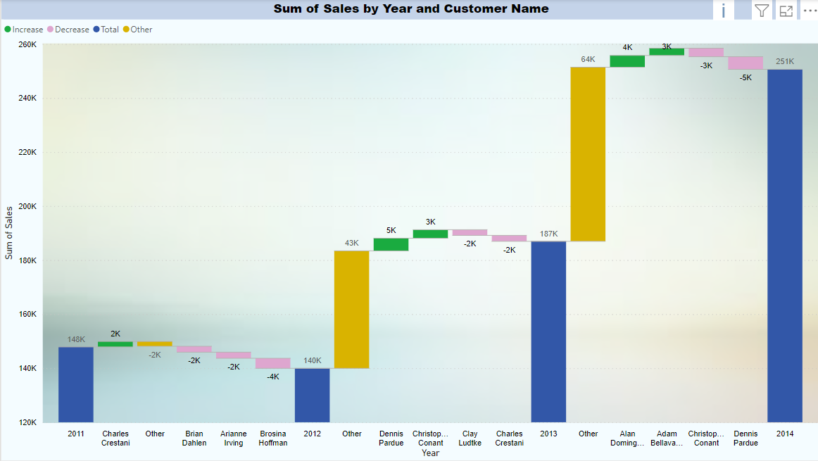
Describe and visualize the principle that 80 percent of the sales come from 20 percent of the customers and also create a visual that would breakdown measures into underlying factors and analyse the sales using the metrics in the data.

Slide 4
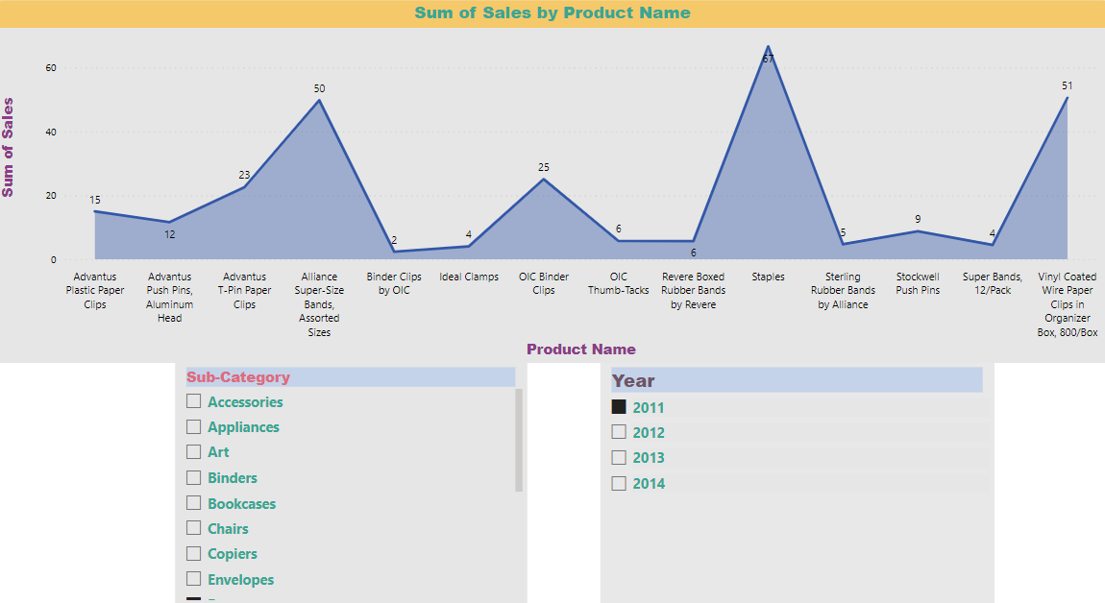
Make a presentation using the dashboards of sale analysis:➢ Sales and Revenue: You can track the store's sales and revenue over time, by category, region, and product.

Slide 5
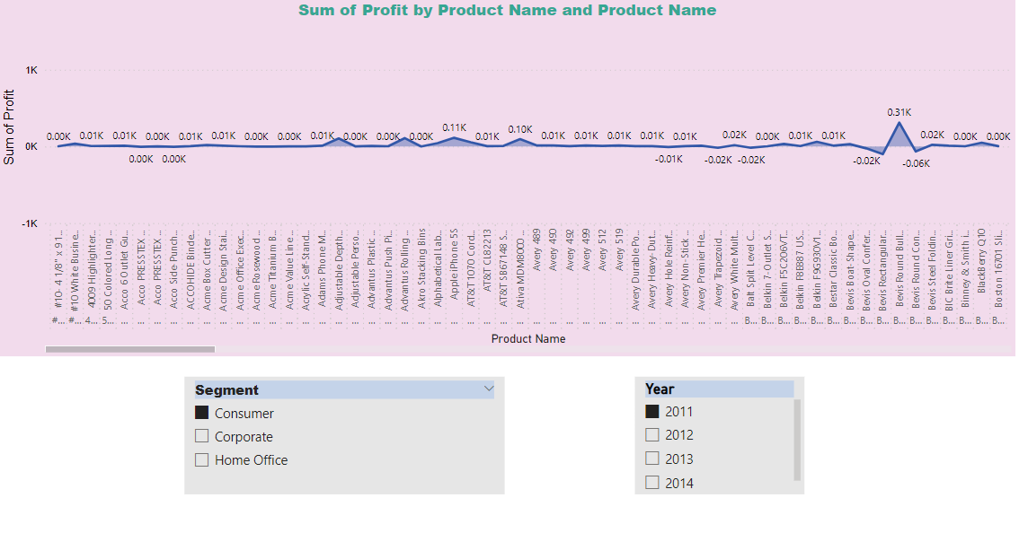

Slide 6
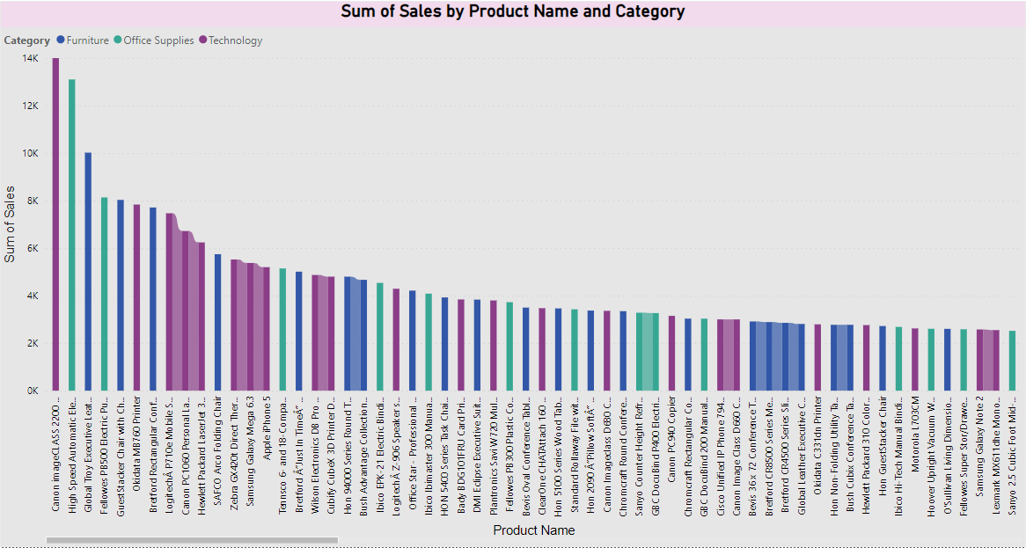
Inventory Management: You can monitor the store's inventory levels and turnover rates to optimize stock levels and ensure adequate supply of popular products.

Slide 7
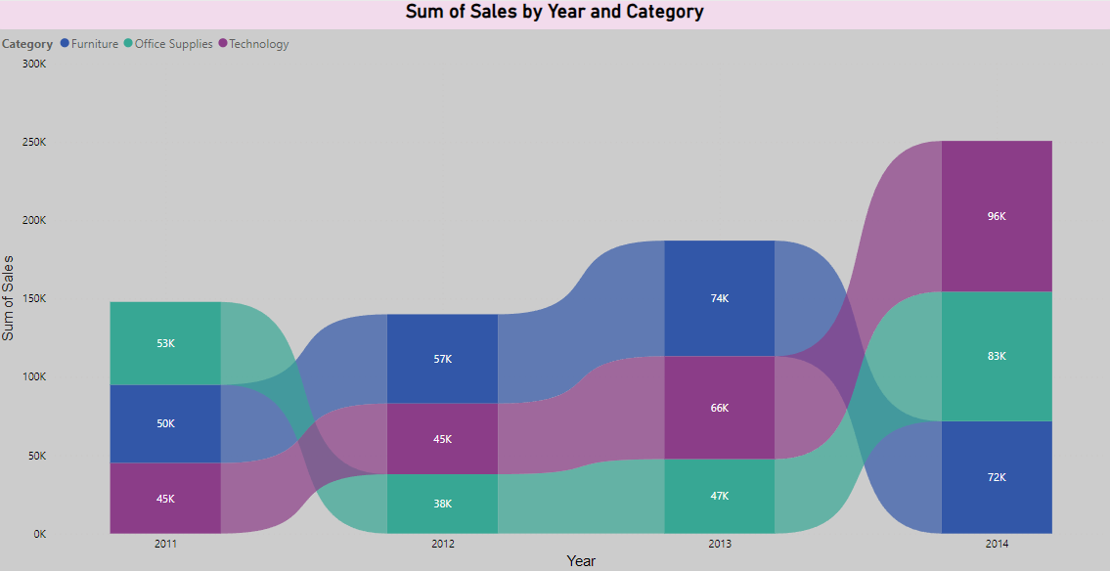

Slide 8
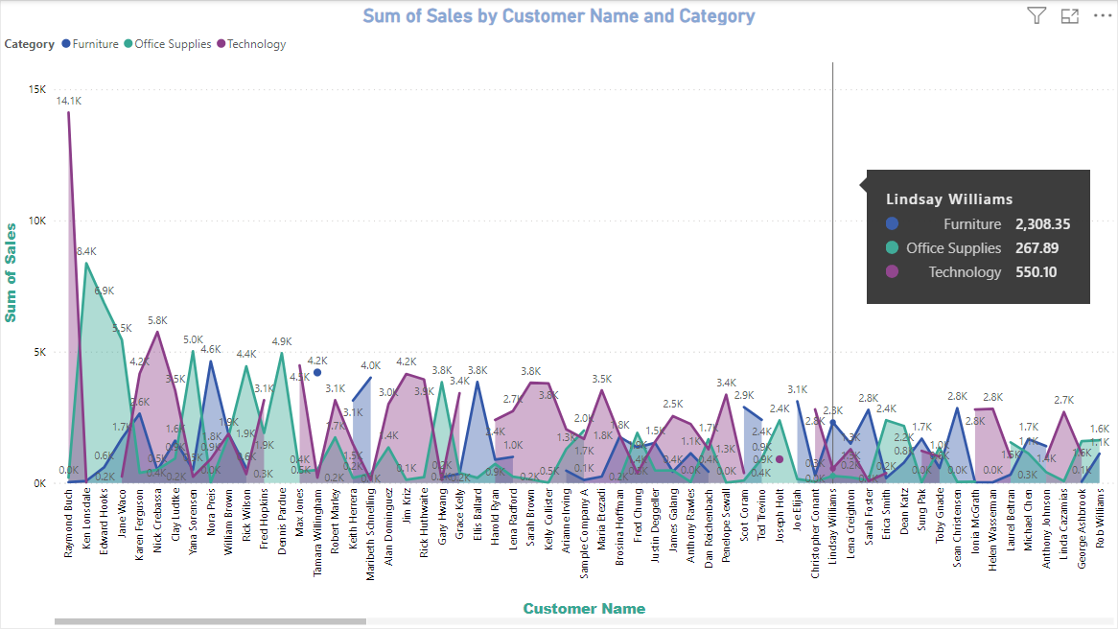
Customer Insights: You can analyze customer data, such as demographics, purchase history, and customer feedback, to gain insights into their behavior and preferences.

Slide 9
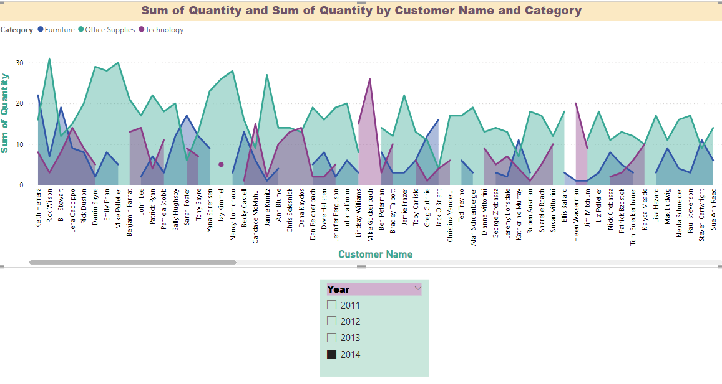

Slide 10
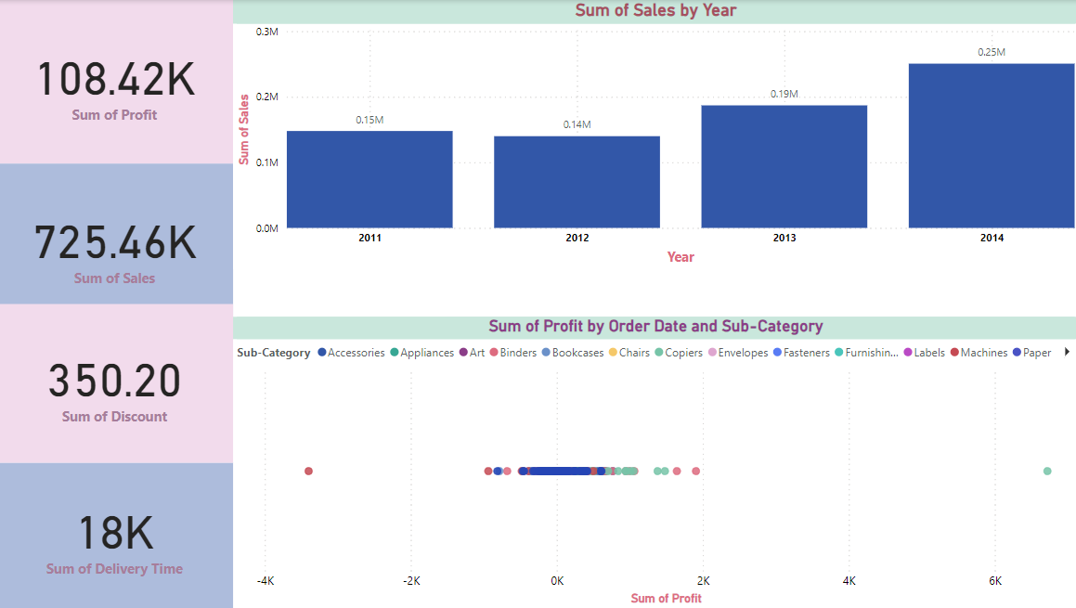
Store Performance: You can measure store performance metrics, such as sales per square foot, customer traffic, and employee productivity, to identify areas of improvement and optimize store operations.

Slide 11
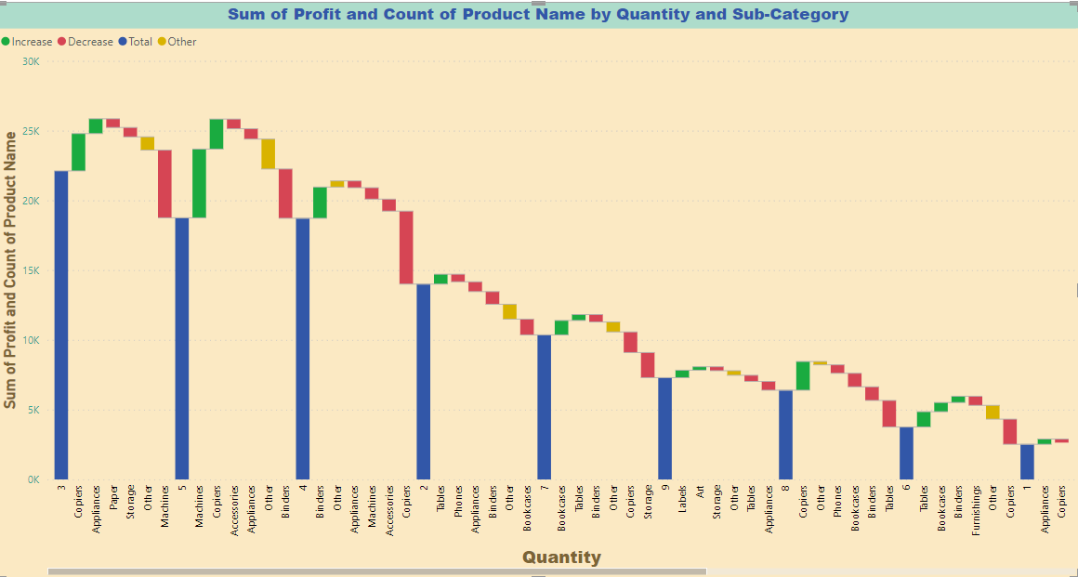

Slide 12
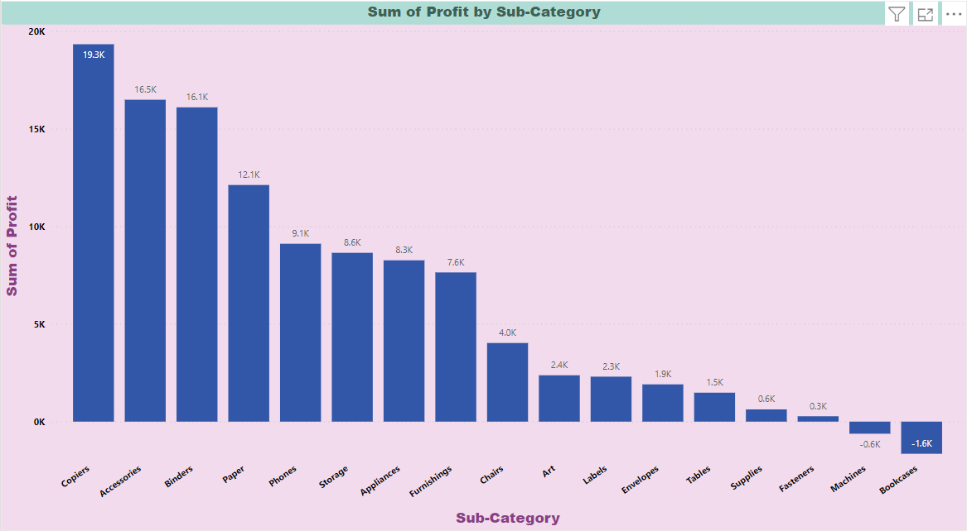
Perform root cause analysis and also make inferences in a report format

Slide 13
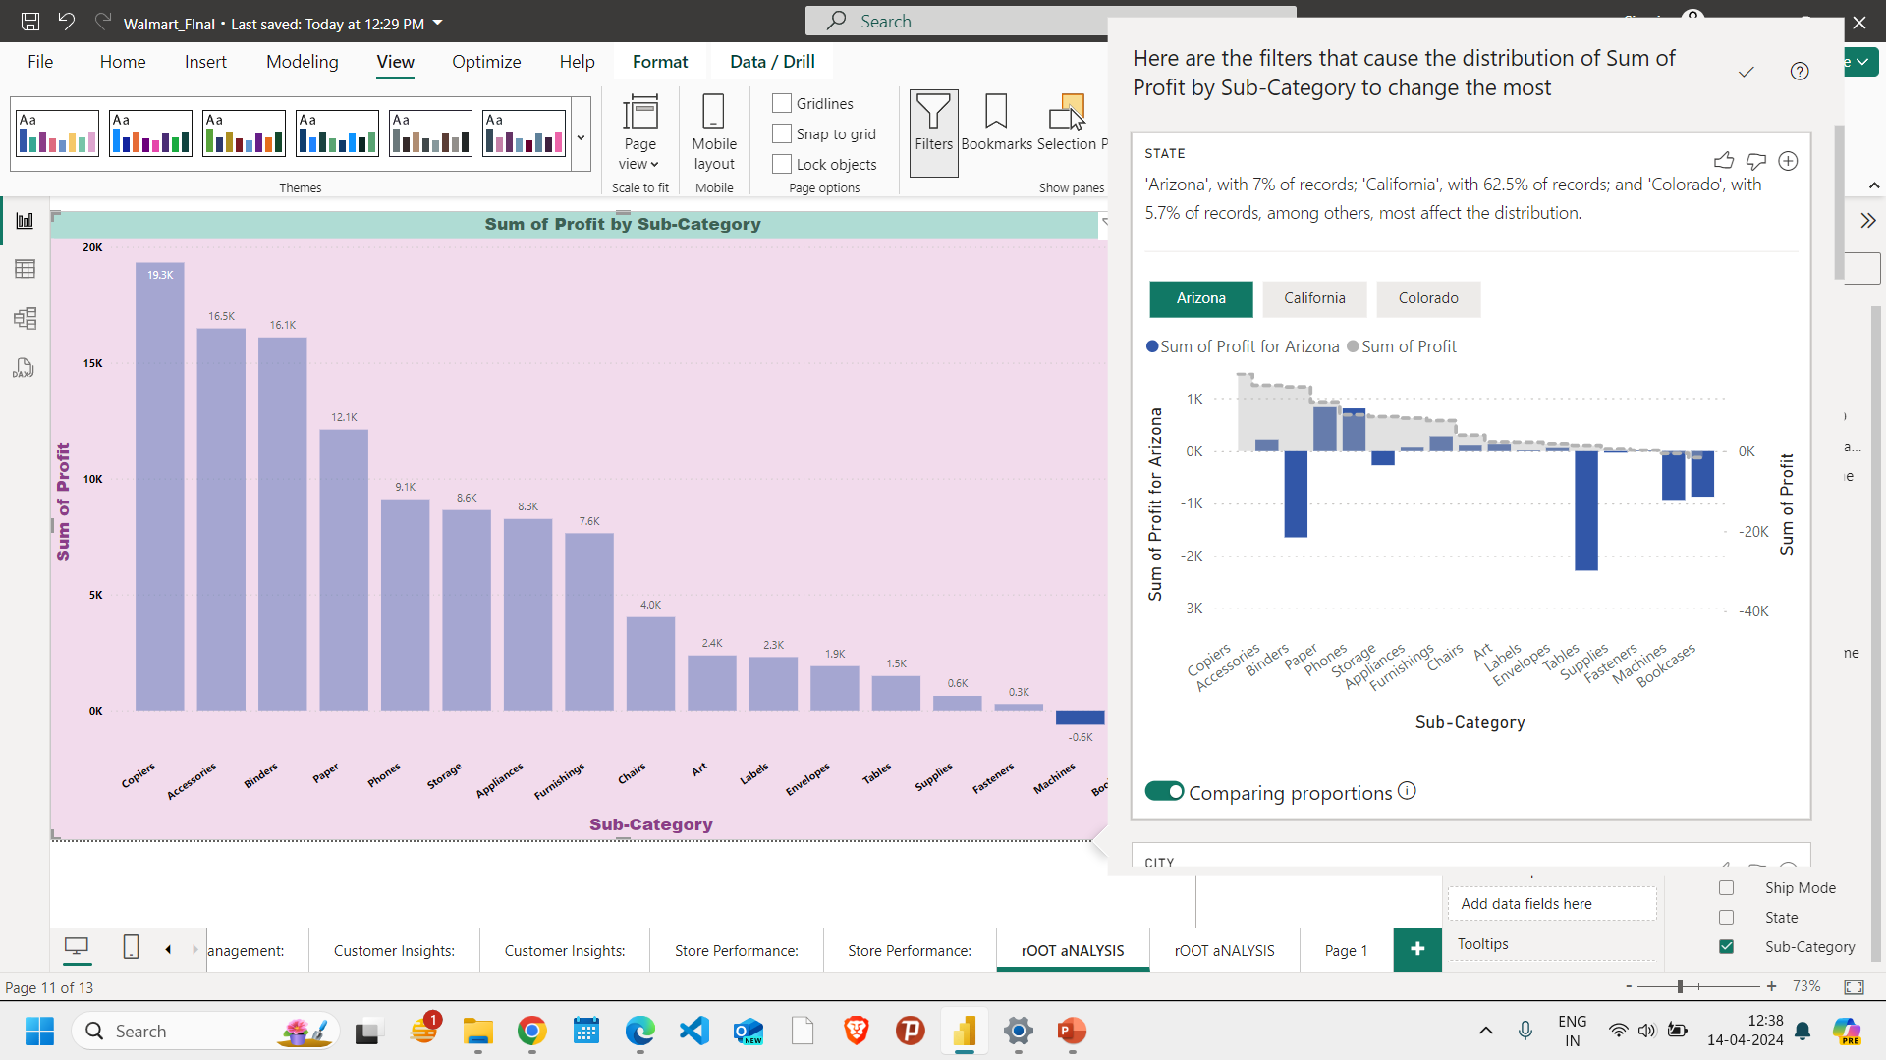

Slide 14
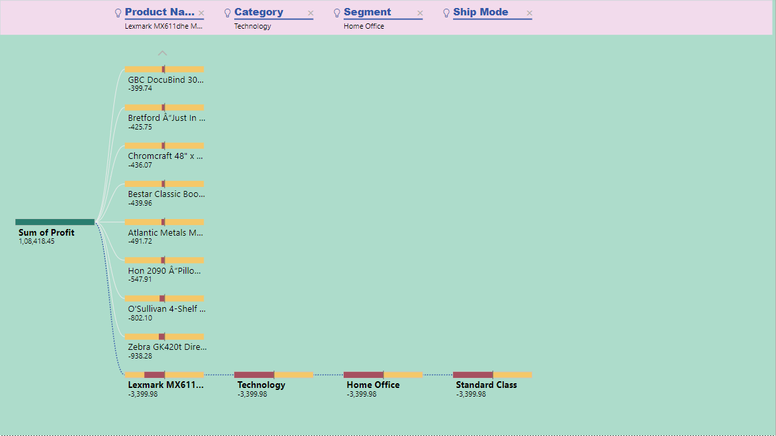

Slide 15


